Slide 1
Enterprise Applications
Server
Desktop
Client
Server
Client
Middleware
Server
Web Client
Middleware
Server
Data Services
Mobility Client
Middleware
Server
Data Services
Wearable's
Cloud

Slide 2


#Digital

Slide 3
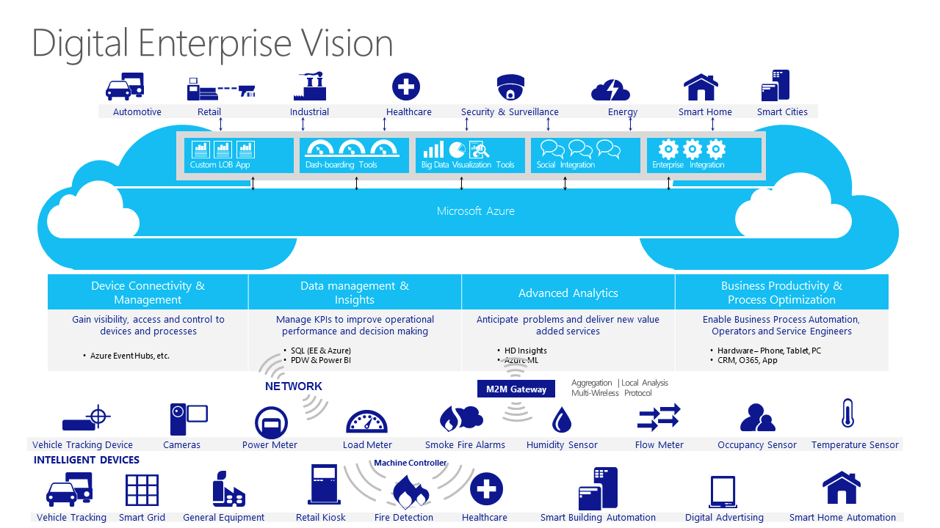

Slide 4
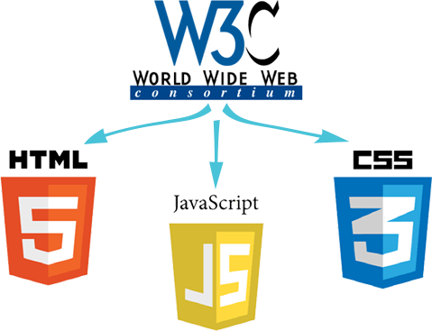
Standards

Slide 5
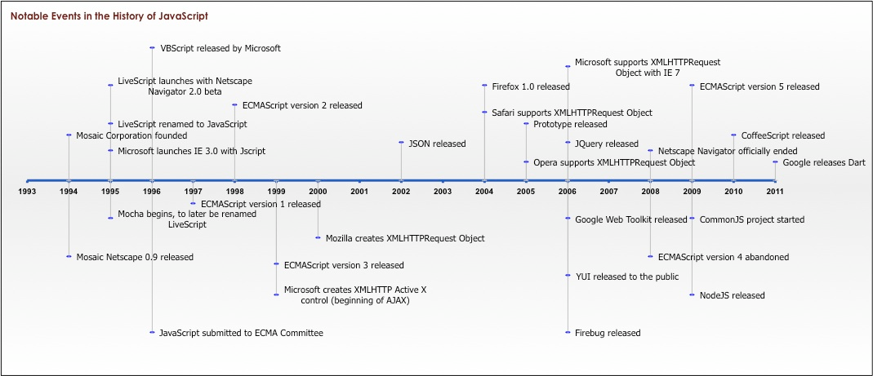
JavaScript!

Slide 6




What is Node.js?
V8 JAVASCRIPT ENGINE
V8 is an open source JavaScript Engine developed by Google for its Chrome web browser.
The V8 engine is extremely fast.
V8 compiles JavaScript to native machine code.
V8 focuses on the web, so it works well with HTTP, DNS, and TCP.

Slide 7
Client
Web Server
Request
HTML,CSS,IMG,DATA,JS
HTML,CSS,IMG,DATA,JS
HTML
CSS
JavaScript
IIS
WebLogic
Web Sphere
JBoss
Apache
Tomcat
Response

Slide 8
Client
Web Server
DATA
Request
HTML,CSS,IMG,DATA,JS
HTML
CSS
JavaScript
IIS
WebLogic
Web Sphere
JBoss
Apache
Tomcat
Response

Slide 9
Lesson-01
MER/AN = MongoDB, Express, React/Angular , NodeJS
Client
Web Server
React /Angular JS
Code is flexible to change & maintainable based on MVC principle
Segregation od Concern into components. Build into JS
TypeScript
ECMA Script Standard, created by Microsoft
Supports OOPS keywords, eg. Class, extends etc..
Provides compile time errors , Compiles into JS
Npm Modules
ExpressJS
NodeJS
JSX = JS+HTML
JavaScript XML
Combines flexibility of JavaScript and HTML to render Views dynamically in React
NODEJS:
Development environment
ExpressJS:
Configures NodeJS as a Web
Server for Deployment
Npm Modules
API to build SPA Apps
BootStrap
Created by Twitter . Open Source. Scaled UI to diff. screen sizes
Supports Responsive Web Design
JQuery
Open Source Library, reduces no. of lines of code
Higher probability of code executing on diff. browsers
Emits JavaScript into the browser
JavaScript
ECMA standard for calling DOM API
Client browser only has JS runtime engine
DOM
W3C API for dynamically modifying the HTML on client side
Parser to convert HTML to tree structure for quick HTML element searches and modification
CSS 3
W3C standard for styling the UI
Mobile Friendly
HTML 5
W3C standard for creating page structure / UI
Mobile Friendly

Slide 10
Web App Deployment Architecture – Segregation Of Responsibility (SRP)
Web Server
App Server
DB Server
Browser
Renders the HTML pages
SPA
Handles HTTP Request
Generates HTTP Response
Handle Data Persistence & CRUD Operations
Handles Multiple users accessing our code
Spawns multiple instances of our Entity/ Biz Logic
Value added services
Memory Mgmt.
Obj pool
Fault Tolerance

Slide 11
Web App Deployment Architecture – Segregation Of Responsibility (SRP)
Angular
React
NGniX
ExpressJS
NodeJS
PM2
NodeJS
MongoDB
NodeJS
Web Server
App Server
DB Server
Browser
Renders the HTML pages
SPA
Handles HTTP Request
Generates HTTP Response
Handle Data Persistence & CRUD Operations
Handles Multiple users accessing our code
Spawns multiple instances of our Entity/ Biz Logic
Value added services
Memory Mgmt.
Obj pool
Fault Tolerance

Slide 12
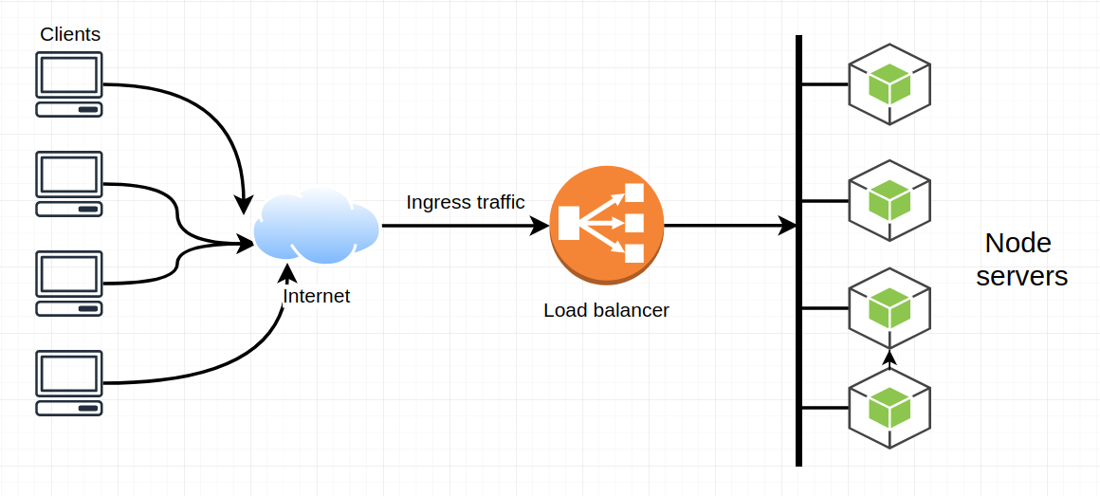
PM2 – NLB
Scalability for multiple requests
NGniX
PM2
NLB
Network Load Balancing
across servers in the cluster

Slide 13
PM2 – Process Manager – Manages Multiple Process of our App
Scalability for multiple requests
NGniX
PM2
Façade with separate port to connect to Web apps running on multiple Node Servers as a cluster
If one server goes down , PM2 routes to the others int the cluster

Slide 14
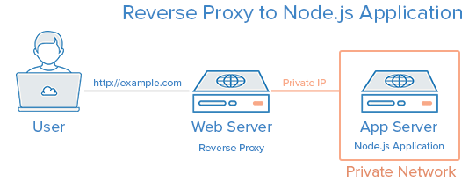
NgNix - Reverse Proxy with PM2 - Security
NGniX
PM2
NgNix
PM2
Web Server
Reverse Proxy
Public and Private IP
Segregation

Slide 15
Sync v/s Async
Sync
Async
Print “Start”
for(i=10;i<20;i++) { //}
Print “End”
Print “Start”
for(i=10;i<20;i++) { //}
Print “End”
Output
Start
10 → 20
End
Start
End
10 → 20

Slide 16
Sync v/s Async
Sync
Async
Render UI
getDataFromDB() {// }
Render UI
Render UI
getDataFromDB() {// }
Render UI
Output
UI Rendered
Retrieve Data From DB
UI Enabled
Data Returned from the DB
UI Rendered
Retrieve Data From DB
UI freezes / disabled
Data Returned from the DB
UI Enabled

Slide 17
Async Callbacks
Render UI
getDataFromDB( callback()=>{
//callback executed once data is returned from the DB
) };
Render UI
Output
UI Rendered
Retrieve Data From DB
UI Enabled
Data Returned from the DB (Notified via the callback function)

Slide 18
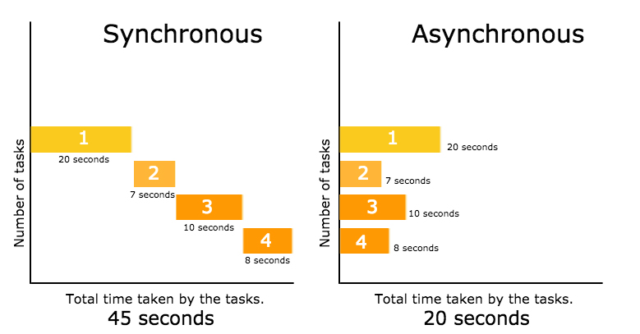
Sync v/s Async

Slide 19
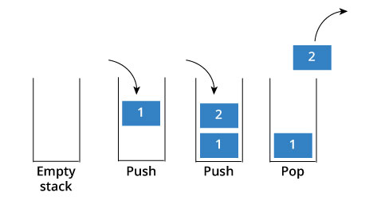
LIFO

